Slide 1
READ & PUBLISH
GUIDE FOR AUTHORS

Slide 2
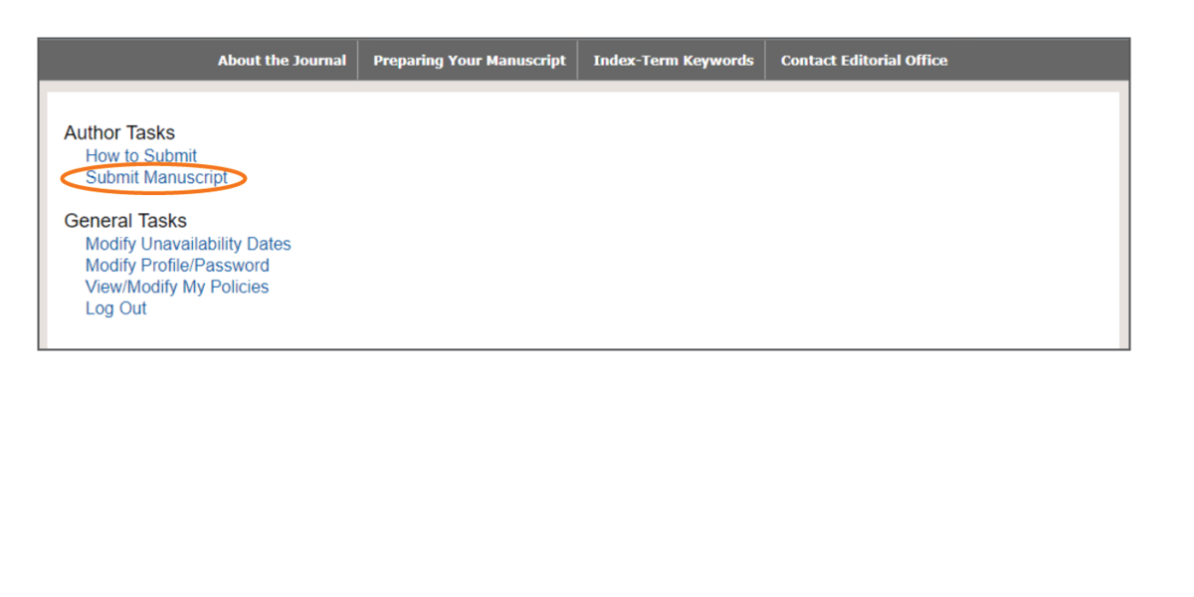
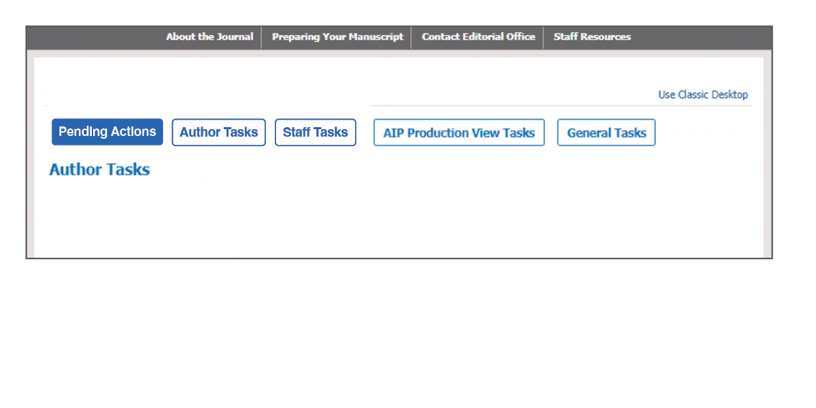
AIP Publishing features a seamless process to submit an article for open access (OA) publishing as part of an institutional Read & Publish agreement. Just follow these simple steps.
1
After logging in, click “author tasks” then select “submit manuscript”. Alternatively, select “use classic desktop” in the upper right corner.

Slide 3
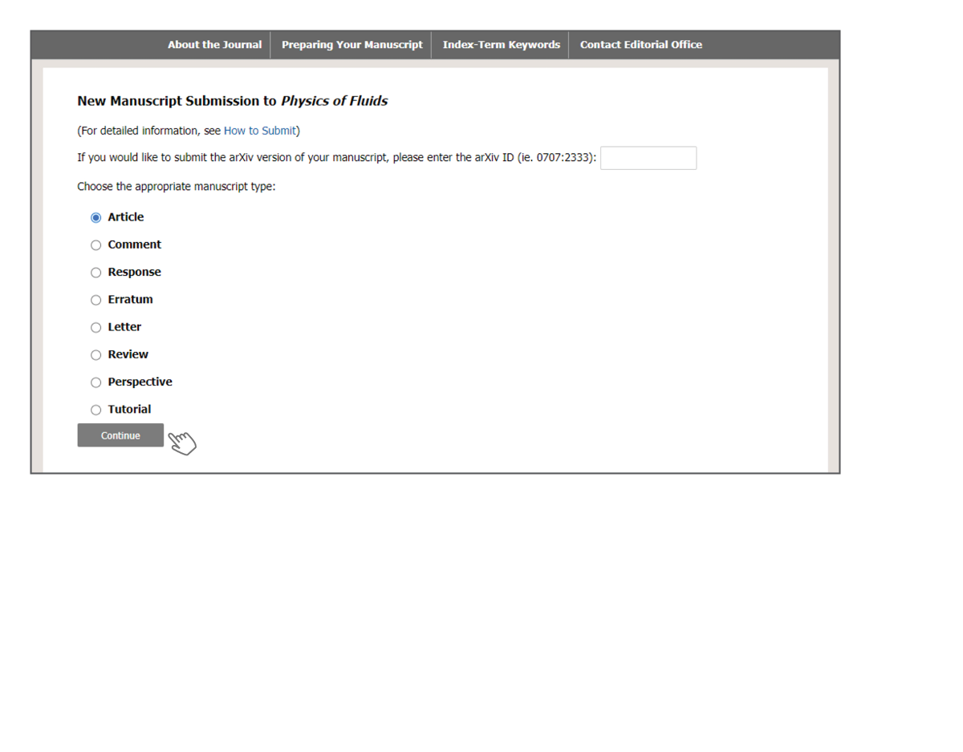
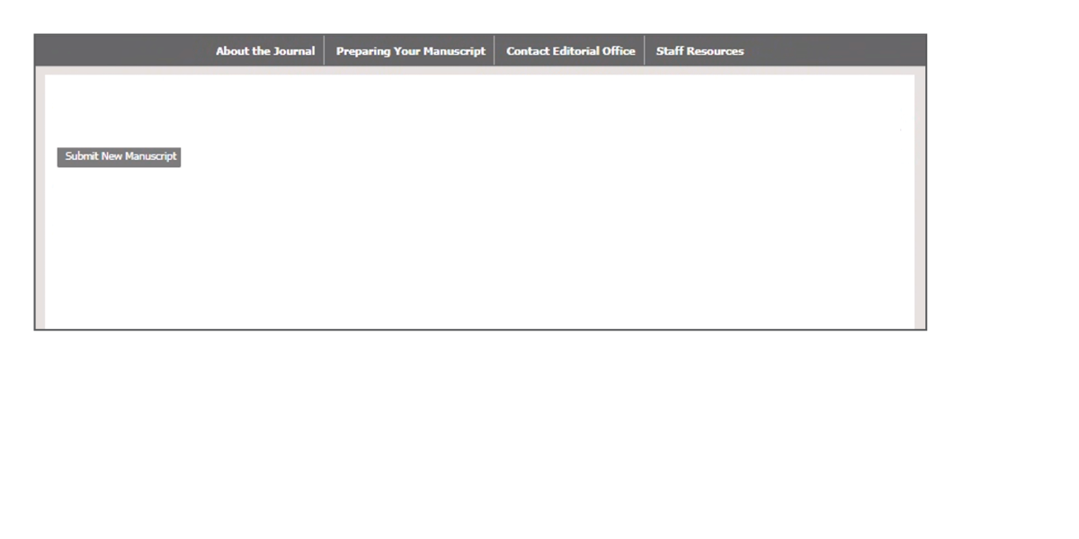
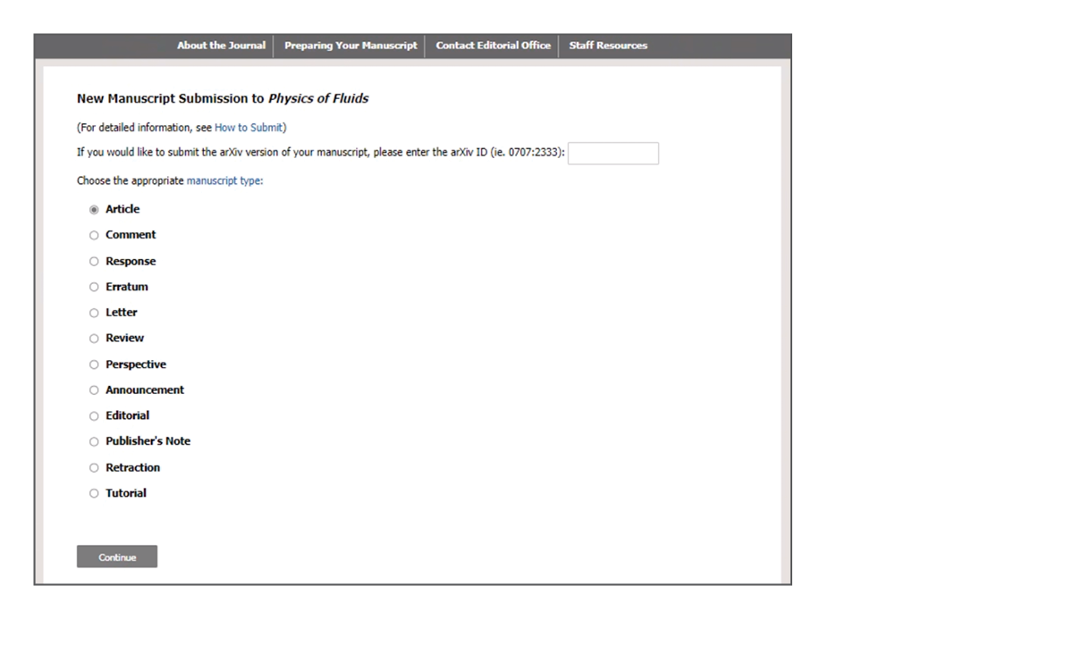
2a
If you do not select “use classic desktop,” the screenshot below will be presented where you can select “submit new manuscript”.
2b
If you select “use classic desktop,” the display will change, as shown below.
3
Next, select the type of manuscript you are submitting.

Slide 4
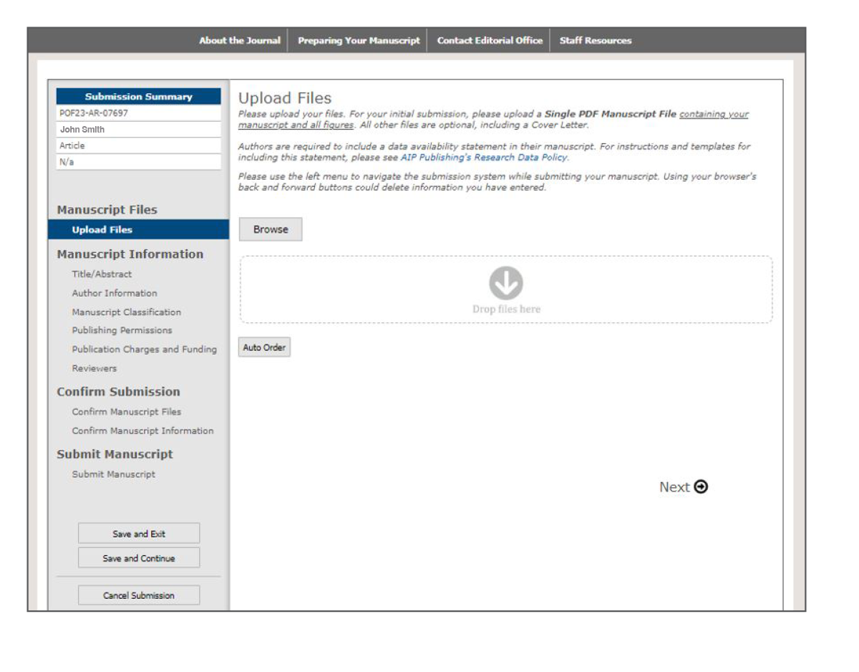
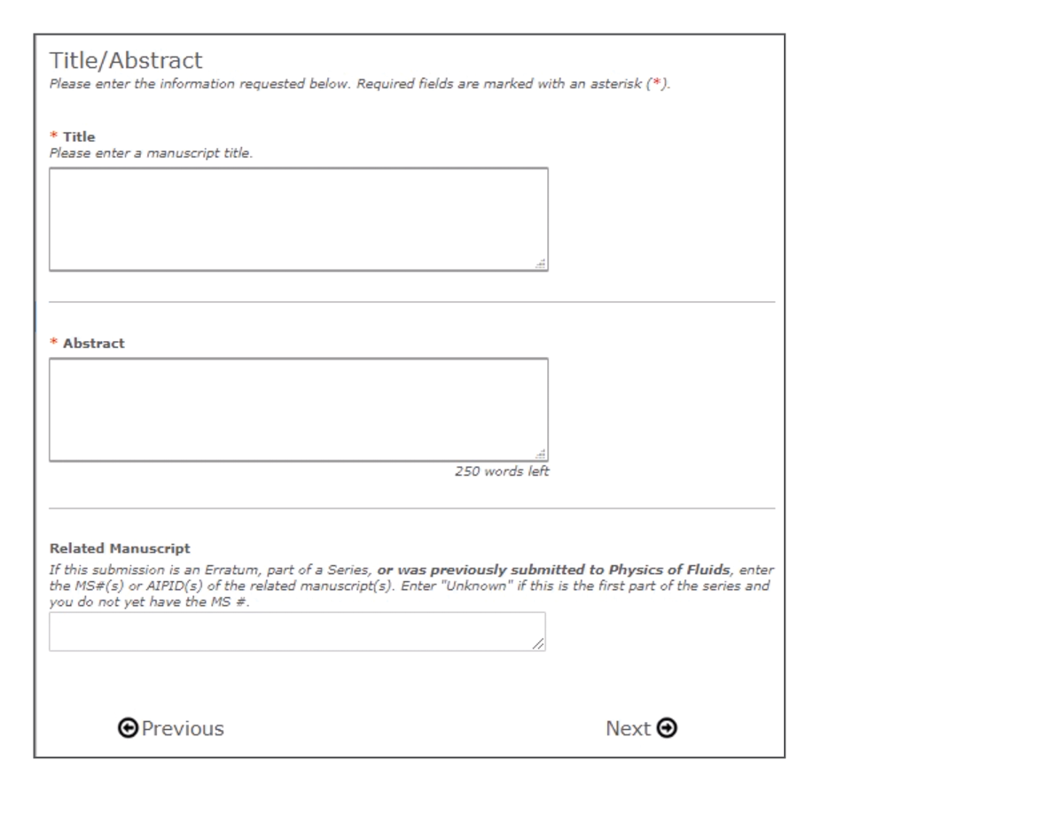
4
5
Provide information about the article including the title and an abstract.
Upload your manuscript file(s).

Slide 5
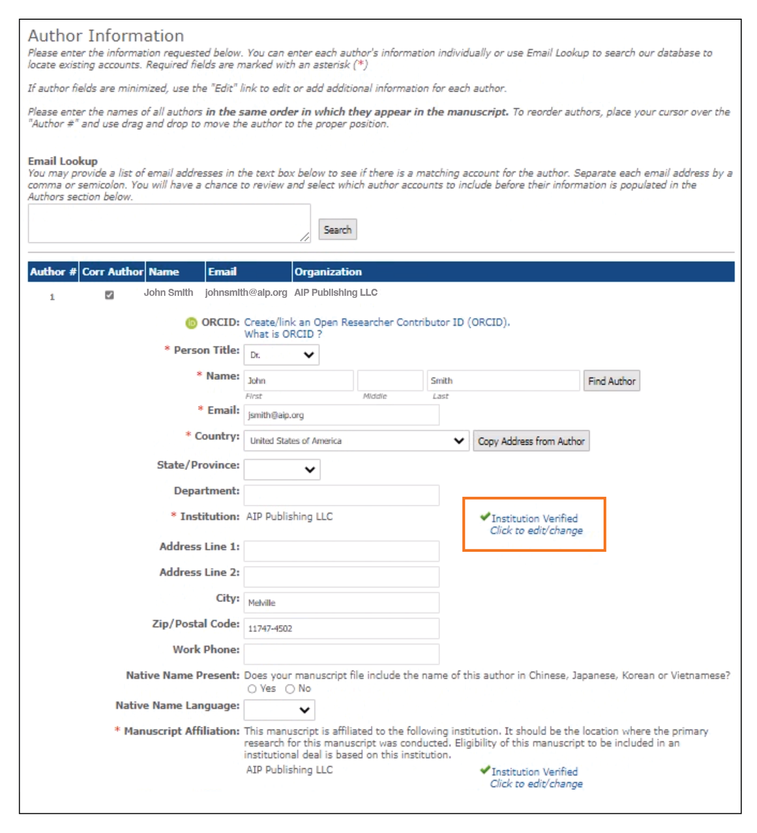
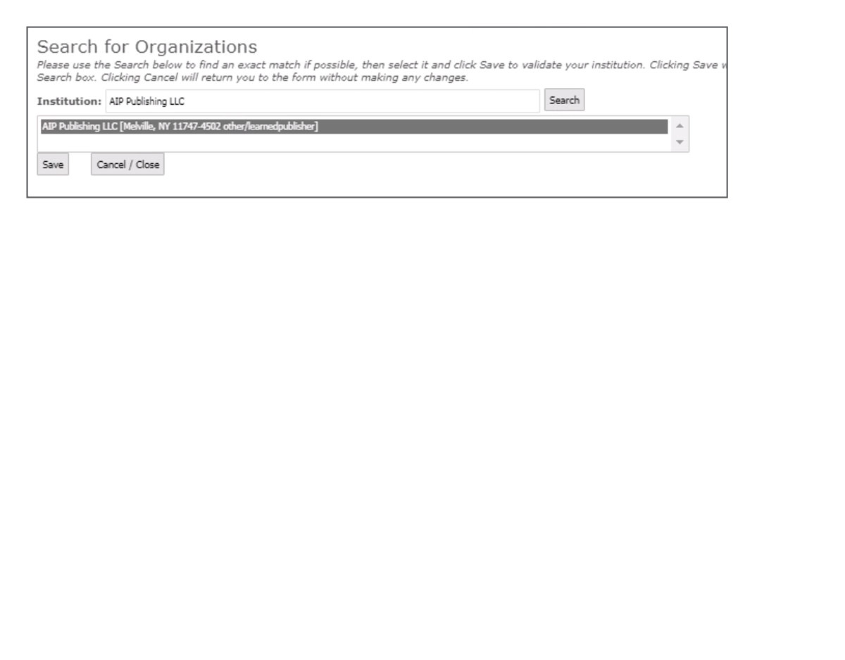
6
Provide the required author information, including name, email, postal address, ORCiD iD, and institution. Select your institutional affiliation by clicking on the “Validate Institution” button and select from the populated organizations shown in the “search for organizations” option.

Slide 6
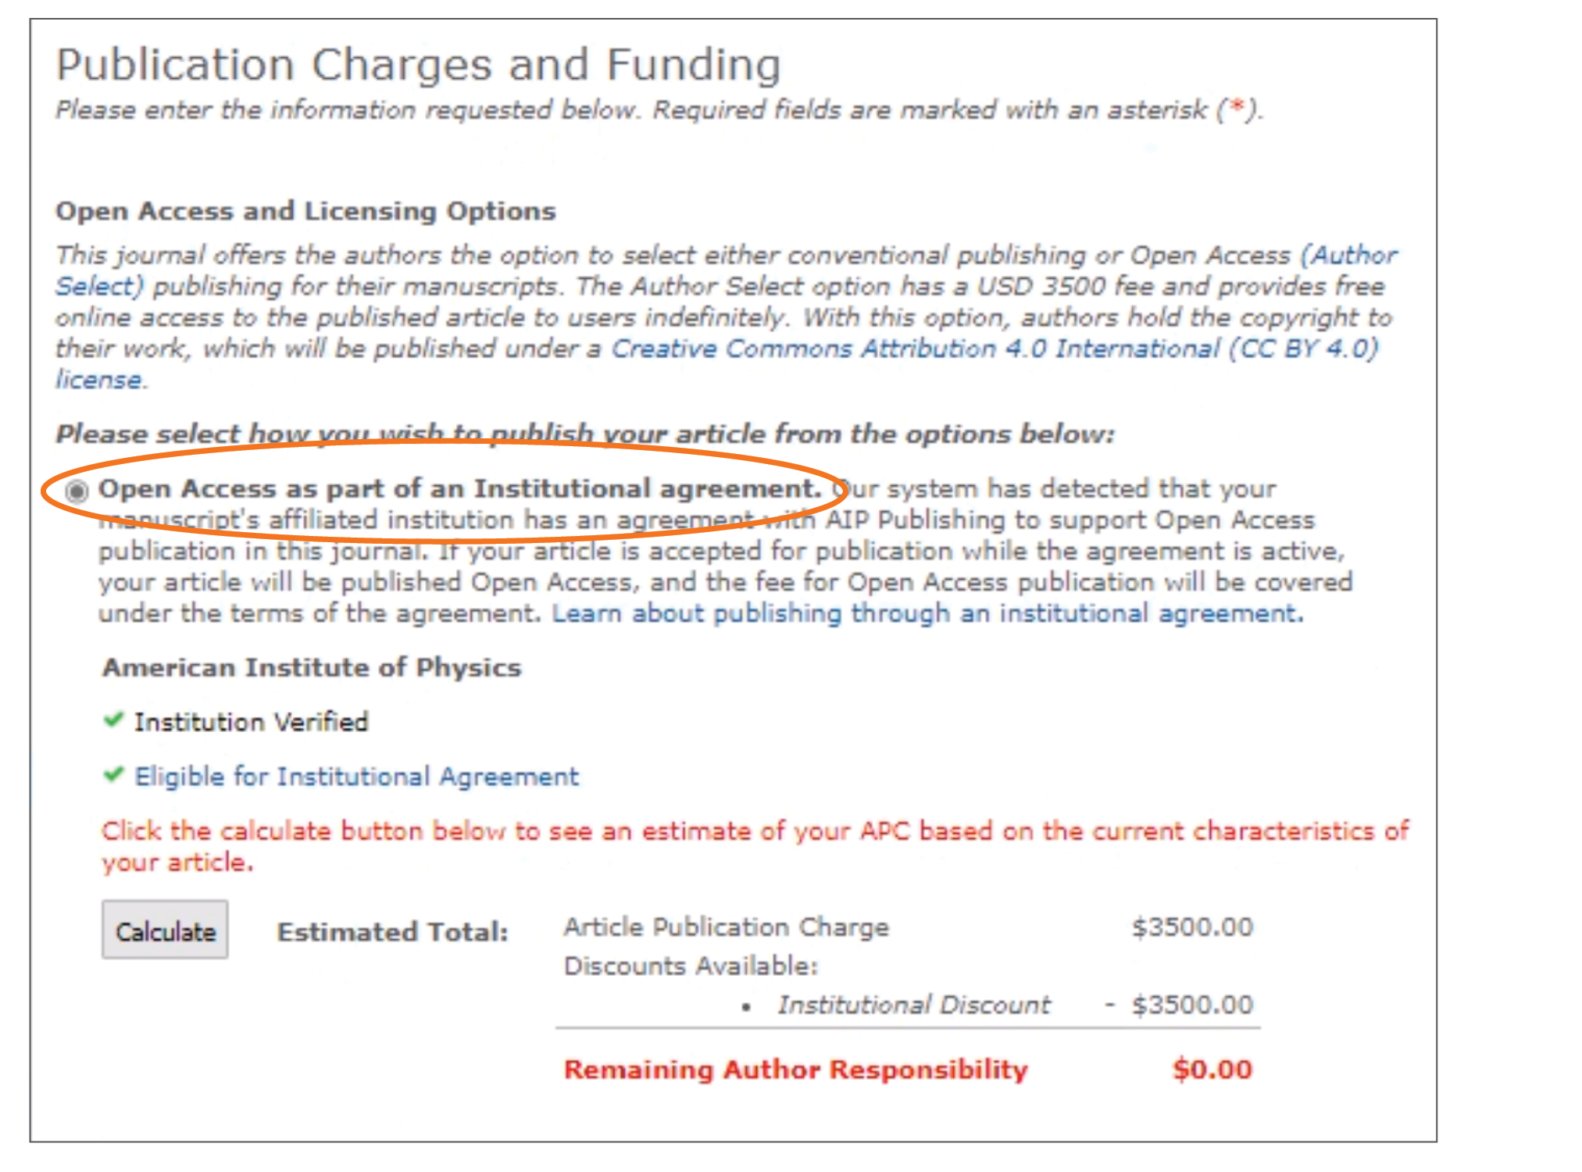
7
Select the option “Open Access as part of an Institutional agreement.” The APC calculation appears automatically, as shown below.

Slide 7
When an article is accepted for publication, the system will verify the status of your institution’s Read & Publish agreement.
If the agreement is still active, your institution will be notified to confirm that publication charges should be applied toward the agreement.
You will receive an invoice that shows that the APC has been paid through the institutional Read & Publish agreement.
If the agreement has been exhausted or expired, you will be contacted with options for how to proceed with publication.
Visit publishing.aip.org/read-and-publish to:
• Verify your institution has a Read & Publish agreement
• Learn more about publishing open access (OA)
• View and download tutorials and available resources

