Slide 1


READ & PUBLISH
GUIDE FOR
ADMINISTRATORS

Slide 2

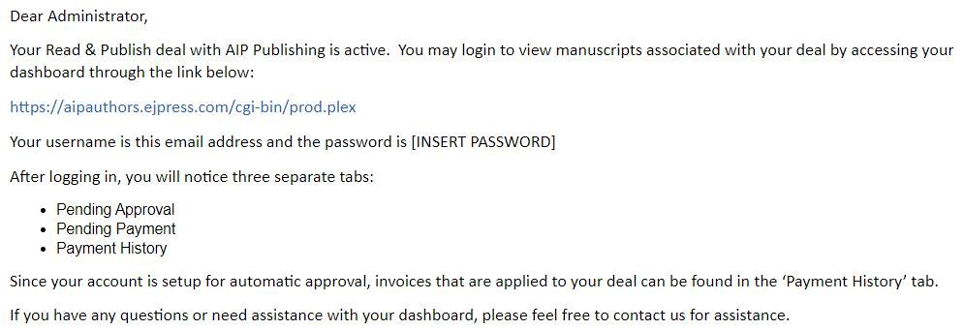
AIP Publishing features a seamless process for administrators to manage submitted articles to publish open access (OA) through an institutional Read & Publish agreement. Follow these simple steps to manage your account through our Administrator Dashboard.
1
After your Read & Publish agreement is set up, a personalized email will be sent to the administrator address on file. It will include information on how to login and your account details.
Sample email:

Slide 3
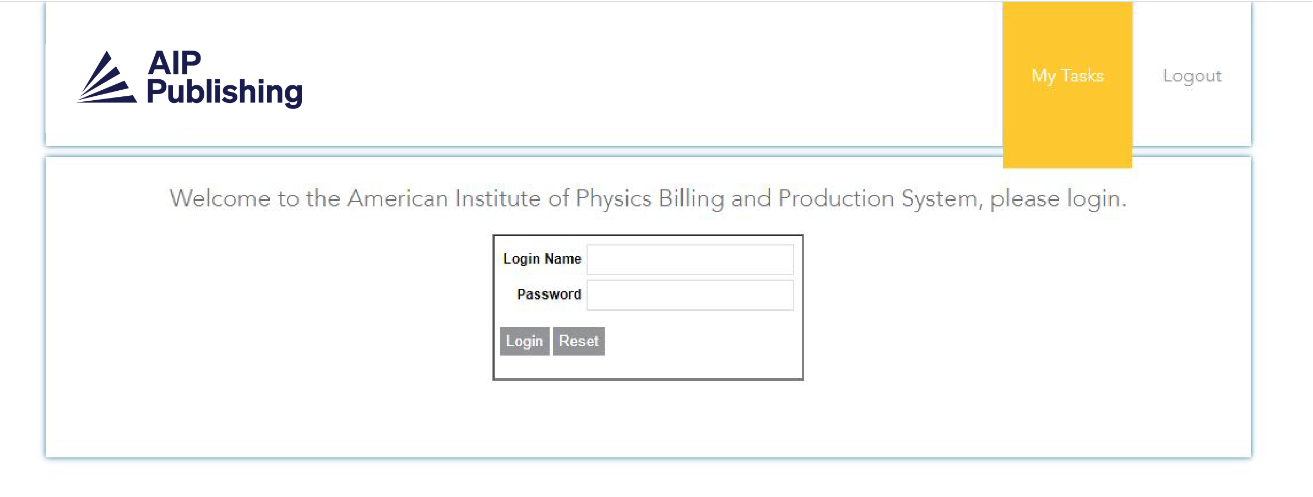
2
After clicking on the link from the email, you will be brought to the login page.

Slide 4
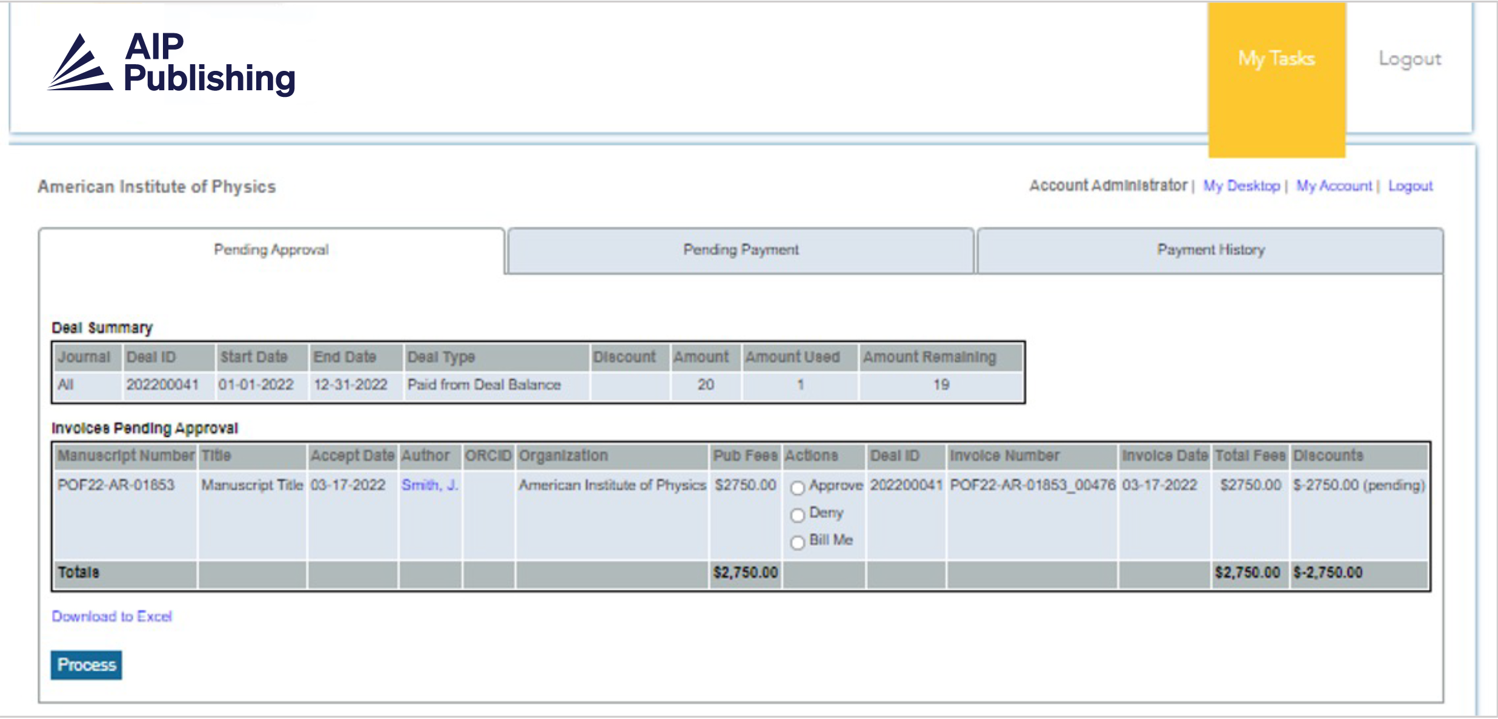
3
Once logged in to the Dashboard, you will be brought to the “Pending Approval” screen. This is an overview of active deals and a list of manuscripts waiting to be reviewed for publication through your Read & Publish agreement. These manuscripts have been accepted for publication and the author has been confirmed as being affiliated with your institution.
You have the ability to select “approve”, “deny” or “bill me.” If you select “bill me,” your institution will be separately invoiced. Manuscripts that you have decided to pay outside of the agreement will appear on the “Pending Payment” tab.
When an agreement is setup for automatic approval, the approve/deny options do not display on this dashboard and the invoice can be viewed directly in the payment history tab.

Slide 5
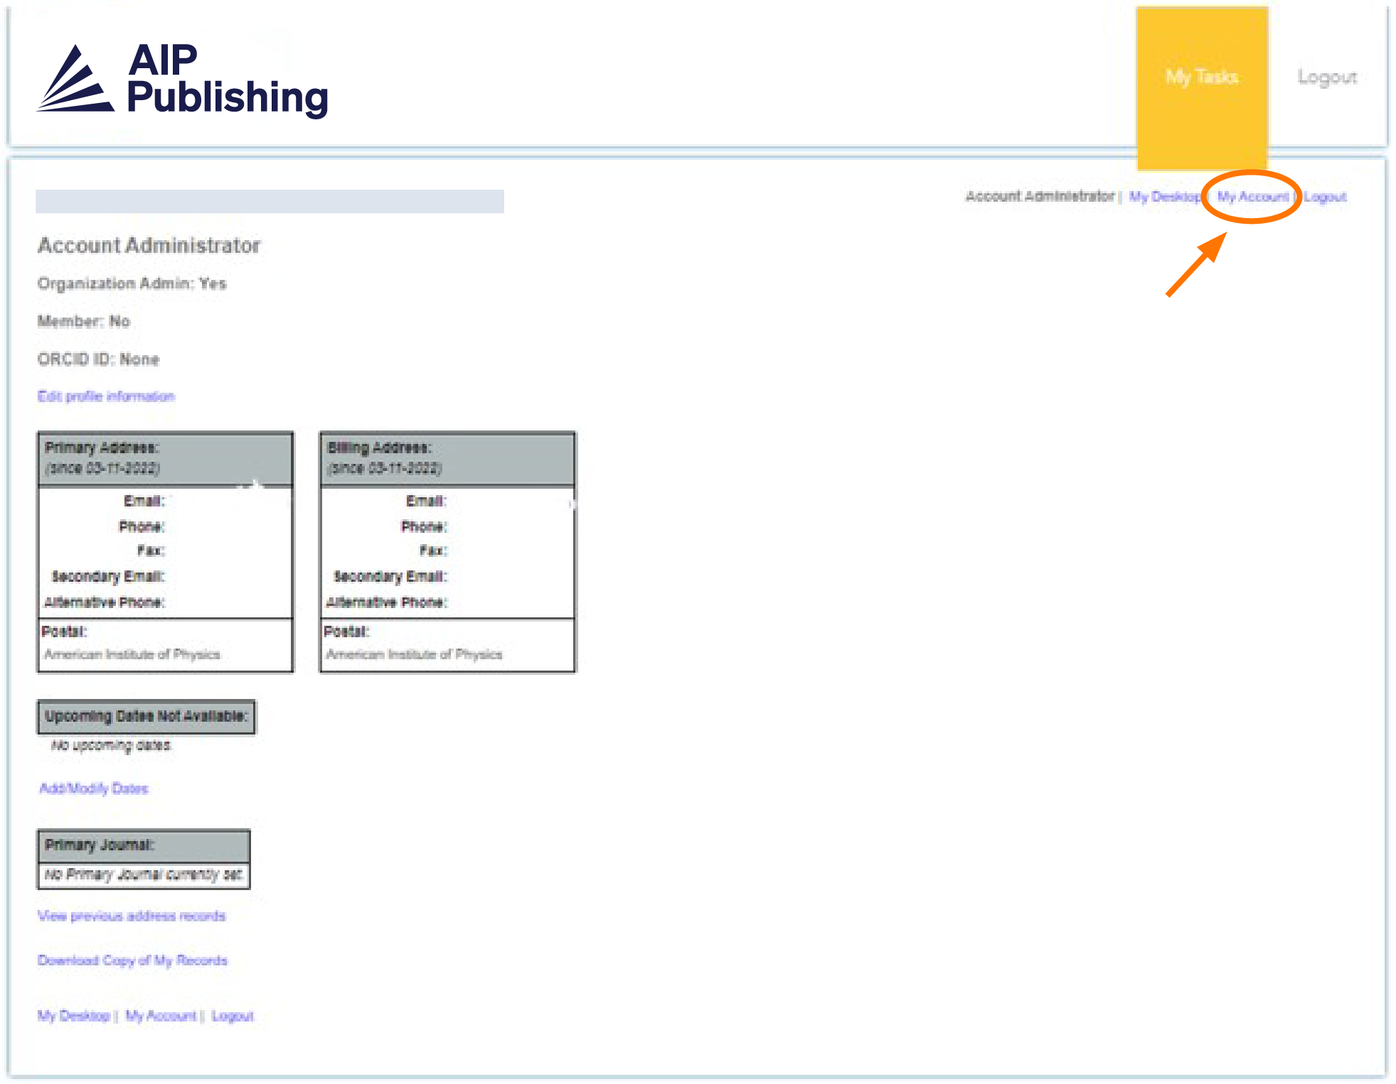
4
You can review your account set up and make any changes by clicking on “My Account.”

Slide 6
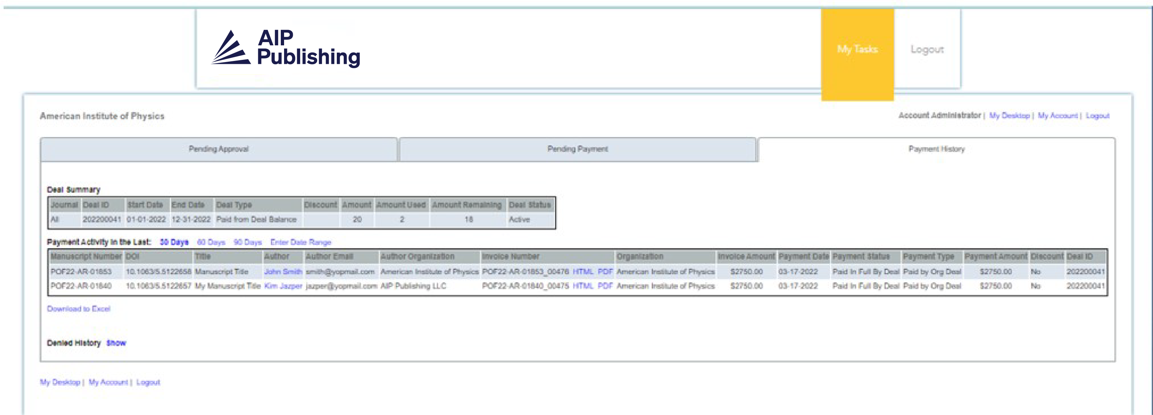
5
The “Payment History” tab will include information from previous and active Read & Publish deals.
Administrators can run a report to see how many articles are initially included in the agreement, how many are remaining, and which manuscripts have been applied to each deal within a selected date range.

Slide 7
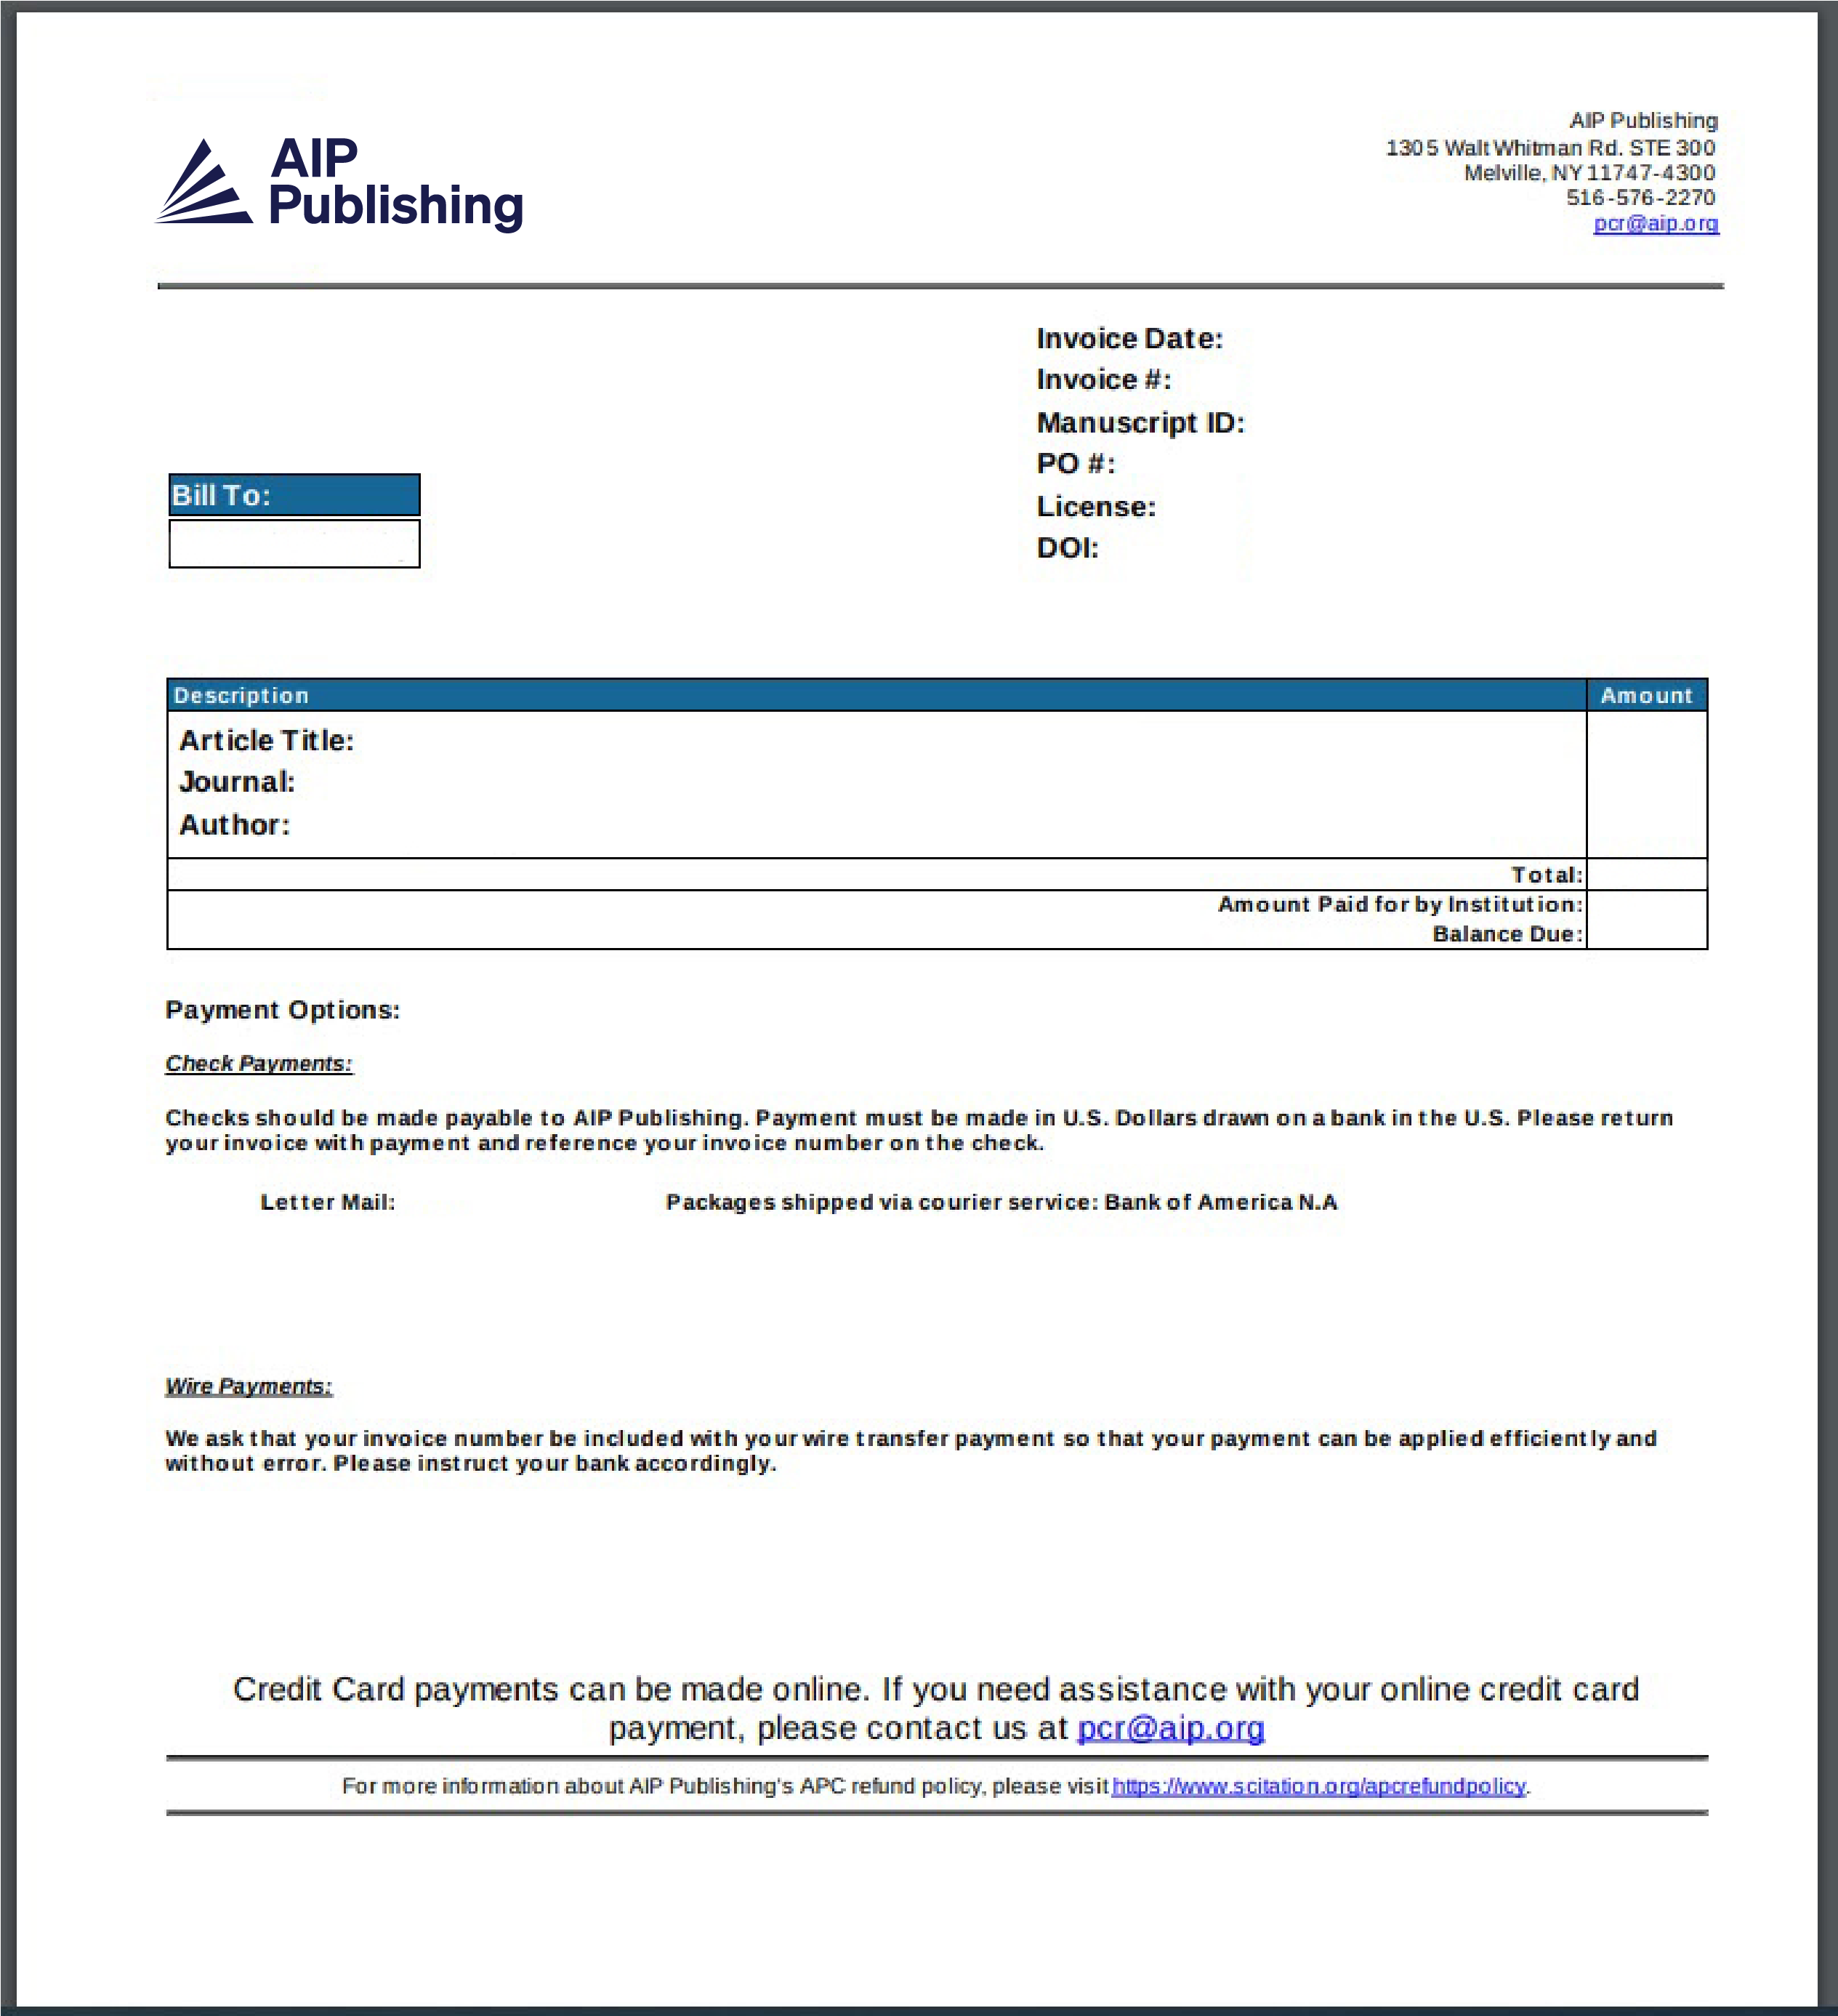
5
You are also able to download individual invoices as a PDF or view in HTML.

Slide 8
Visit publishing.aip.org/read-and-publish to:
• Learn about ways to let your
users know they can publish
open access
• Request customized promotional
tools and resources
• To view, download, and share the
Read & Publish Guide for Authors

